Slide 1
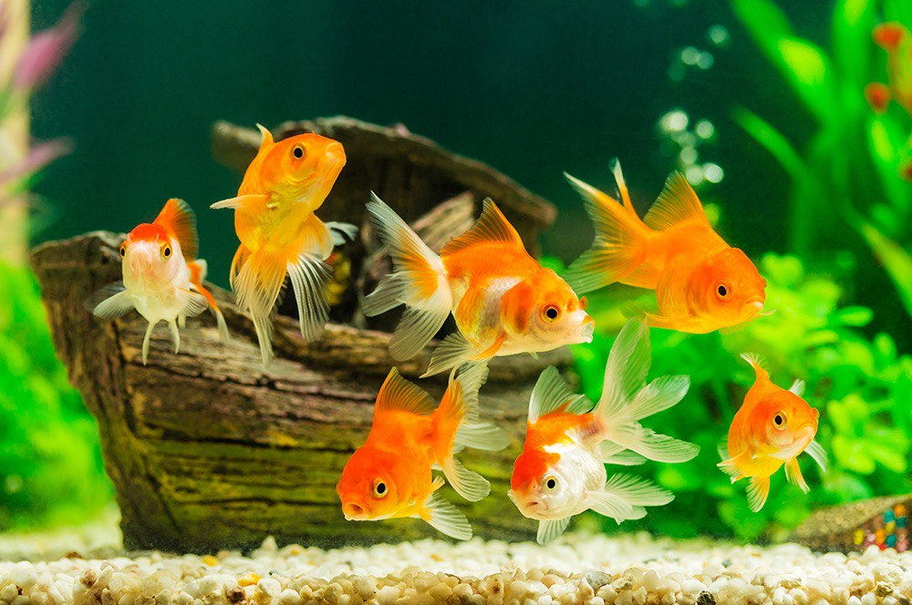
Endothermism in fishes
GROUP FOUR(4)
BIOL 454

Slide 2
outline
INTRODUCTION
DEFINITON AND EVOLUTION OF ENDOTHERMY IN FISHES
EXAMPLES OF ENDOTHERMIC FISHES
CHARACTERISTICS OF ENDOTHERMIC FISHES
MECHANISMS OF HEAT PRODUCTION AND TEMPERATURE REGULATION
BENEFITS OF ENDOTHERMISM IN FISHES
CHALLENGES AND LIMITATIONS
CONCLUSION
REFERENCES
NAMES AND INDEX NUMBERS

Slide 3
INTRODUCTION
Endothermy is the ability of an organism to maintain relatively constant and elevated body temperature independent of the surrounding environment. It is mostly associated with birds and mammals.
Most fishes are ectotherms which means they regulate their body temperature dependent on their surrounding environment but a few fishes exhibit endothermy and they are known as endothermic fishes.

Slide 4
Definition and evolution of endothermISM In fishes
Endothermy in fishes is relatively rare but it has evolved in several lineages. Mackerels, tunas and billfishes (suborder scomboidei and Teleostei) provide an ideal context to examine the evolution of endothermy.
Two major hypotheses were made about the selective forces which led to the evolution of endothermy in fishes. These hypotheses are;
Thermal niche expansion
Enhancement of aerobic swimming performance

Slide 5
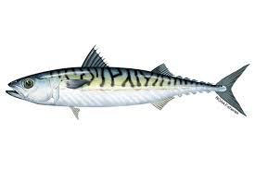
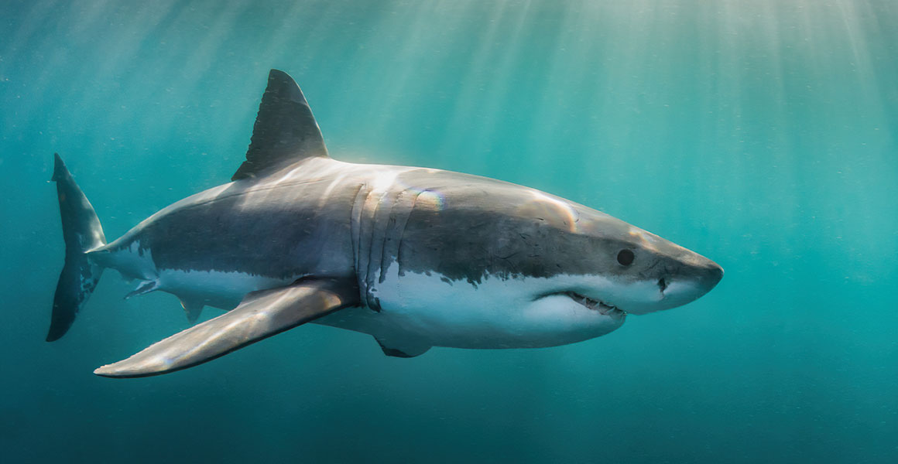
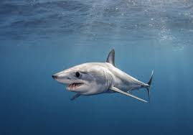
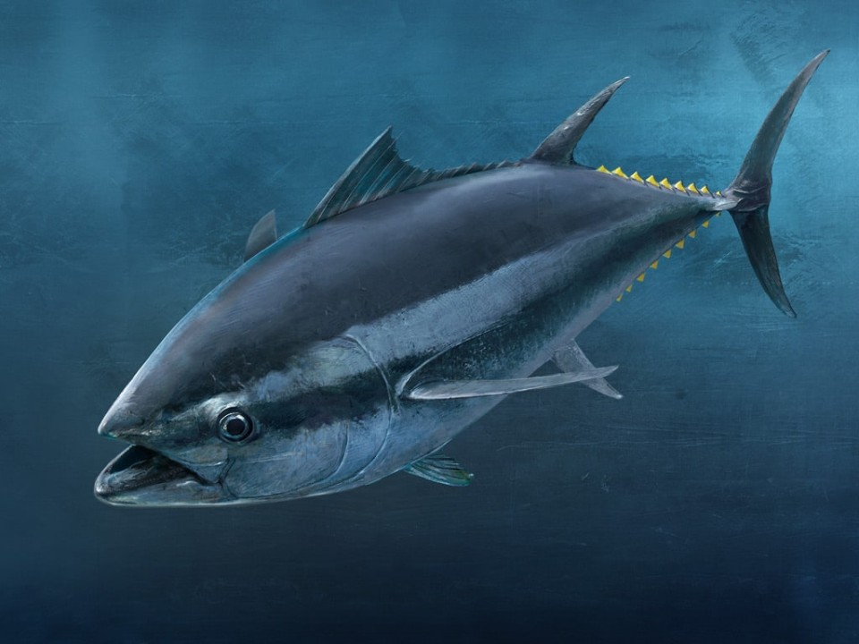
Examples of endothermic fishes
Some examples are; bluefin tuna, yellowfin tuna, mackerels, bonitos, great white shark, mako shark, etc.

Slide 6
CHARACTERISTICS OF ENDOTHERMIC FISHES
Endothermic fishes possess different characteristics that differentiate them from ectothermic fishes. Some characteristics are;
High metabolic rate
High oxygen consumption
Rete mirabile
Enhanced sensory receptors

Slide 7
MECHANISMS OF HEAT PRODUCTION AND TEMPERATURE REGULATION
Endothermic fishes generate and maintain their body heat internally. They have certain mechanisms that support their active lifestyle and aid in survival on wide range of environment. Some mechanisms are;
Muscular activity
Vascular heat exchangers
Insulation
Regional heterothermy

Slide 8
CHALLENGES AND LIMITATIONS
High oxygen consumption
Increased feeding habit or vulnerability to food scarcity

Slide 9
ADVANTAGES OF ENDOMITHERISM IN FISHES
Endothermy in fishes provide several advantages that contribute to their survival and ecological success. Here are some advantages;
Enhanced swimming performance
Competitive advantage
Extended range and habitat flexibility
Increased sensory abilities

Slide 10
conclusion
It is important to note that although some fishes exhibit characteristics of endothermy, their level of endothermy is not comparable to that of birds or mammals. The mechanism they possess allow for regional or partial endothermy which allow them to maintain slightly elevated body temperature in specific areas of their body.

Slide 11
REFERENCES
“Fish physiology” series (various volumes) edited by William s. Hoar, David J. Randall, and Anthony P. Farrell
“The Physiology of Fishes” by David H. Evans. “Physiology of Elasmobranch Fishes” edited by Robert E. Shadwick, Anthony P. Farrell and Colin J. Brauner.
Research Papers from reputable scientific journals such as journal of Fish Biology, Journal of Comparative Physiology B and Fish and Fisheries.

Slide 12
NAMES AND INDEX NUMBERS
AGBOTTAH PATAND EUODIAS – 9197019
ADUTWUMWAA GYAPONG WENDY – 9196219
SARPONG EWURABENA SEFAH – 9218919
ASAMOAH AFUA- 9201819
DUSHIE ELIOENAI DZIDUDU – 9207319
OPOKU KELVIN MENSAH – 9215219
AMOH GODFRED – 9199219

Slide 13


